Slide 1


DAY 1 - EARNINGS
- OFFSIDE SCALP
Omar Ghias
$SMCI
August 12, 2026

Slide 2


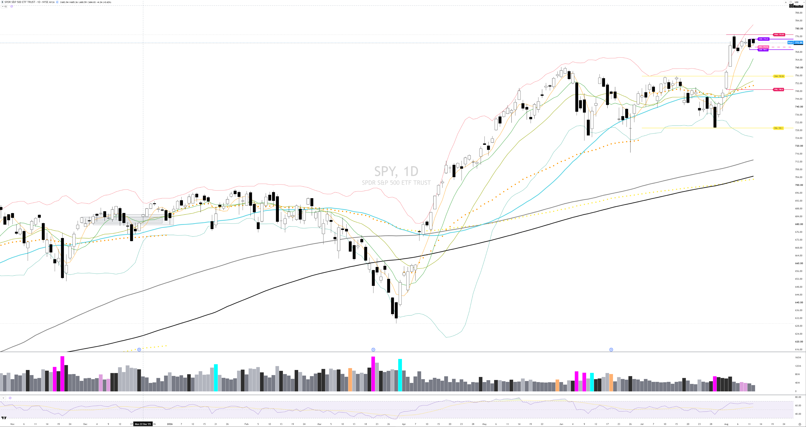
THE BIG PICTURE
$SPY
TECHNICAL: SPY sits in a confirmed uptrend, closing at 772.49, just 0.56% below its 52-week high of 776.85 set August 5. Price is stacked above all four key moving averages: the 9-day (767.08), 20-day (753.19), 50-day (748.12) and 200-day (704.50), running about 9.65% over the 200-day. The tape has climbed off the June 26 swing low of 716.58, gaining 2.75% over the past month as it pressed back toward the highs.
FUNDAMENTAL: The broad rally that commenced July 30 accelerated into early August, with the S&P 500 closing at a record high supported by strong corporate earnings, a rebound in tech shares and hopes for progress reopening the Strait of Hormuz, surging 1.79% to 7,737, its first record in two months. Among the reasons cited were optimistic comments from Treasury Secretary Bessent, booming earnings and a chart breakout. More recently, oil rose as traders assessed mixed signals from the U.S. and Iran amid worries a deal to open the Strait may not come soon, tempering the surge.

Slide 3
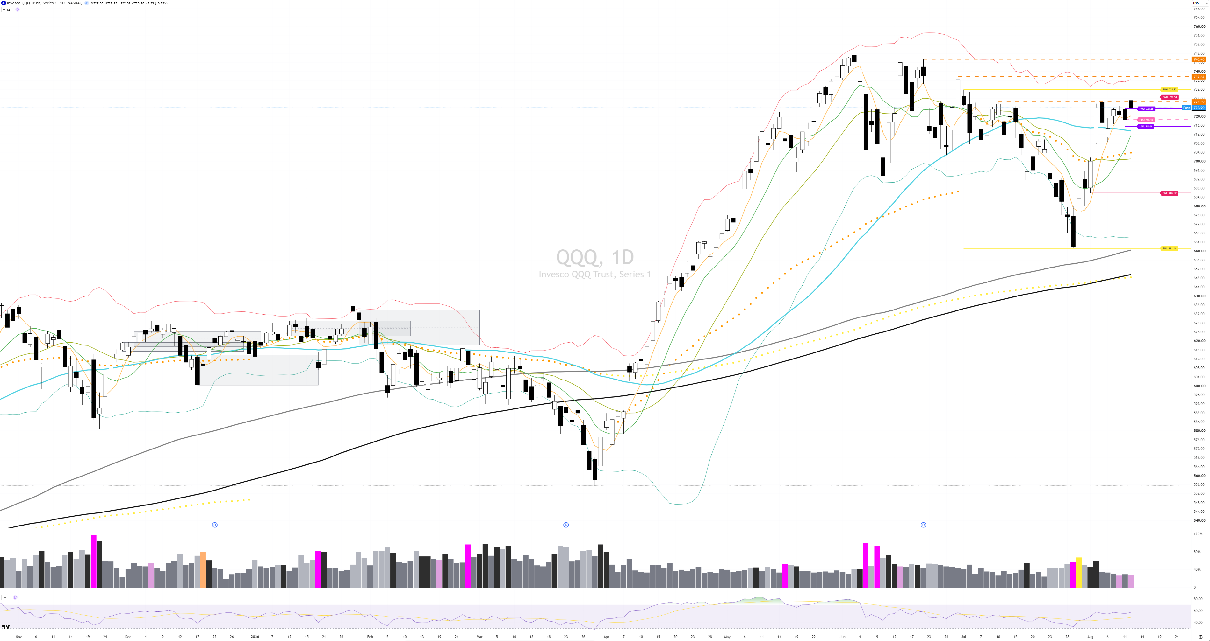
THE BIG PICTURE
$QQQ
TECHNICAL: QQQ holds an uptrend, closing at 723.70, sitting 3.33% under its 52-week high of 748.65 from June 3, which also marks the recent swing high. Price is above the 9-day (714.43), 20-day (701.03), 50-day (713.49) and 200-day (649.53), running roughly 11.42% over the 200-day. The rebound from the July 29 swing low of 661.14 has been sharp, though the past month shows only a 0.56% gain as the tape consolidates near prior peaks.
FUNDAMENTAL: Tech led the rally that began July 30 after a wobble, as the Nasdaq 100 rose over 3% Tuesday after dropping into a shallow correction the prior week. The move rides an AI-capex theme, with Bank of America maintaining a buy on Nvidia as a top pick, calling memory and 'circular financing' concerns overblown and expecting a revenue beat and raised outlook ahead of its report on Aug. 26. Megacaps have lagged the broad index, as the Magnificent Seven fund is up only around 5% in 2026 versus the S&P 500's 13%, underscoring recent rotation.

Slide 4
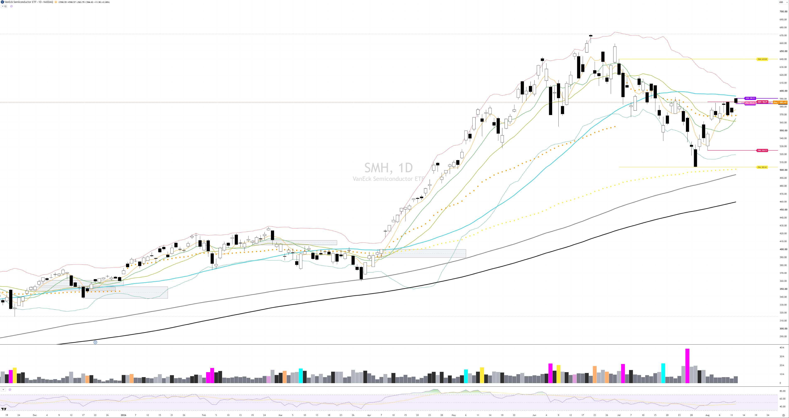
THE BIG PICTURE
$SMH
TECHNICAL: SMH is flagged in a downtrend despite a recent bounce, closing at 584.83, sitting 12.95% below its 52-week high of 671.83 set June 22, which is also the recent swing high. Price is above the 9-day (568.08) and 20-day (561.53) but 1.44% below the 50-day (593.35), while holding roughly 27.22% over the 200-day (459.70). The last month is down 2.58%, though a rally off the July 29 swing low of 503.63 lifted it 2.66% on the week and 2.08% on the session.
FUNDAMENTAL: Semiconductors remain anchored to the AI-capex story, and Q2 earnings season confirmed AI capex is accelerating, with global semiconductor sales hitting a record $120.6 billion in May 2026, up 104.1% year over year and marking a 15th consecutive monthly record. Memory is a key driver, as it remains the biggest source of growth, accounting for roughly 77% of the year-to-date increase, with DRAM and NAND benefiting from higher pricing and volumes. The breadth is widening, with ex-memory semiconductor sales reaching $63.5 billion in June, up 38% year over year, a third consecutive month of accelerating growth. The group still trails the broad tape after a summer pullback from June highs.

Slide 5
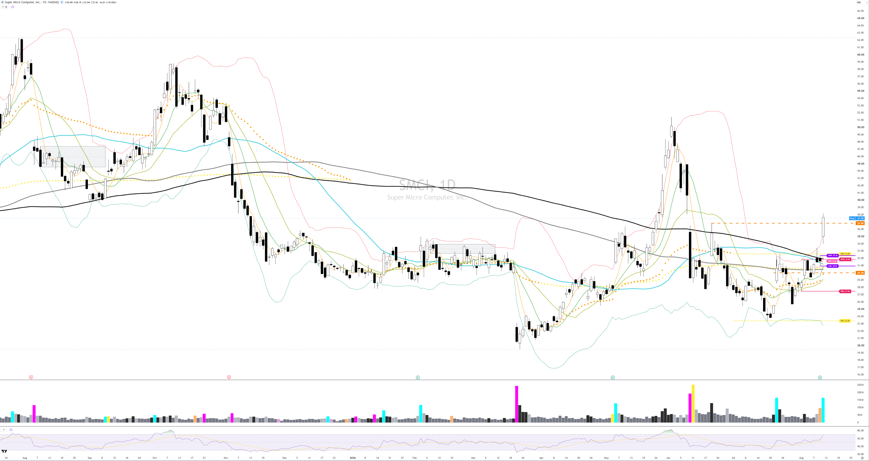
THE BIG PICTURE
$SMCI
TECHNICAL: SMCI is in an uptrend and just went vertical, closing at 37.61 after a 19.02% single-session jump, up 36.02% on the month. Price now towers over every key average, sitting roughly 20.79% above the 9-day (31.14), 29.25% above the 20-day (29.10), 20.61% above the 50-day (31.18) and 17.83% above the 200-day (31.92). Even so, it remains 36.02% under the 52-week high of 58.78 from last October and 93.07% above the March 23 low of 19.48. The move blew past the June 2 swing high of 51.40 context after basing at the July 17 swing low of 23.38.

Slide 6
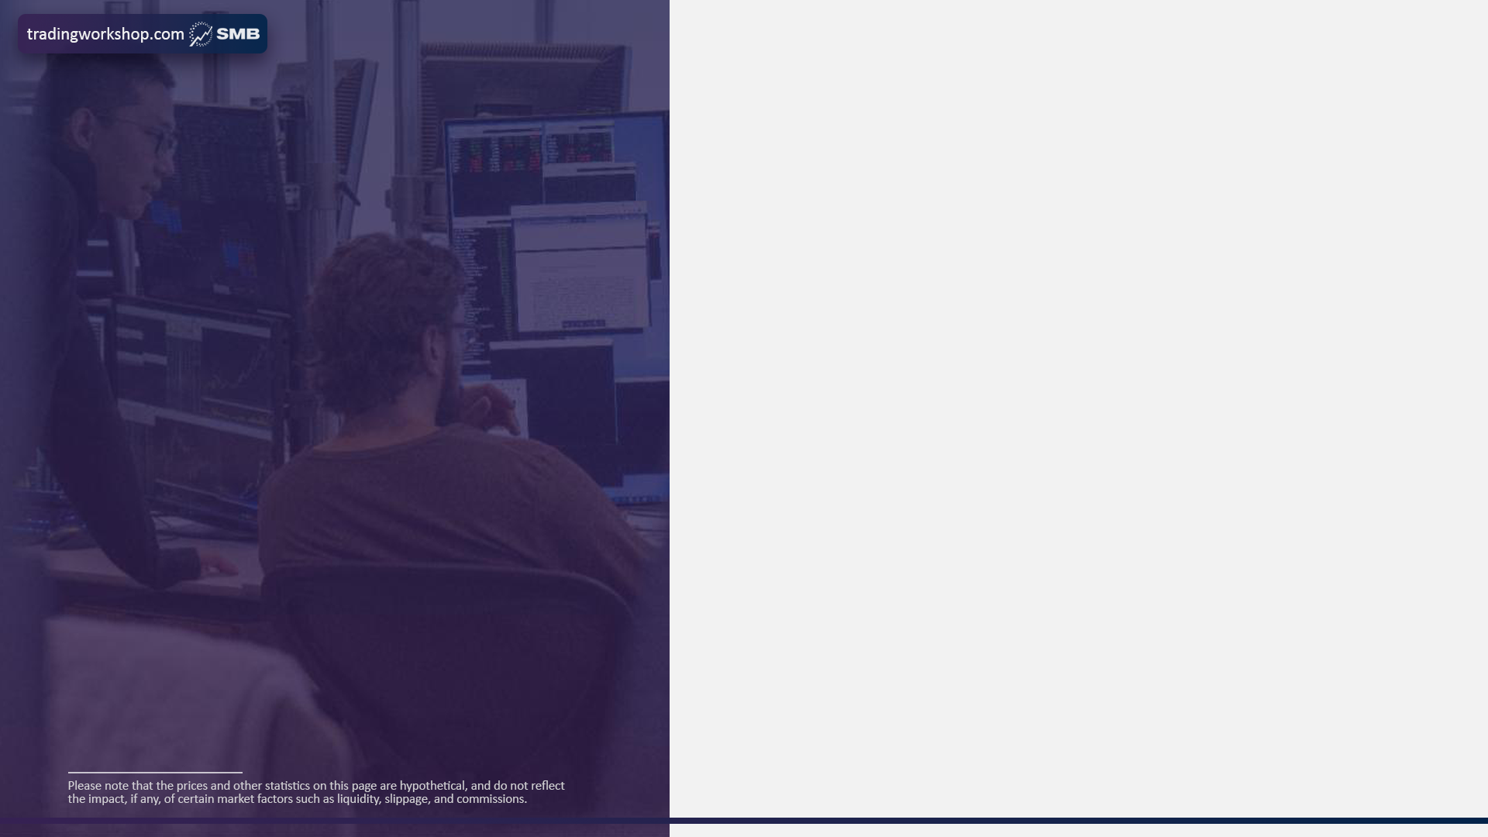
RVOL (full day)
Avg Volume (20d)
INTRADAY FUNDAMENTALS
3.37x
49.14M
The gap higher was driven by the fiscal Q4 report released on the trade date, where Super Micro posted a disappointing miss on revenue but a big beat on the bottom line, revenue of $11.1 billion versus $11.551 billion expected and EPS of $1.62 versus $0.96 expected. Margins were the headline surprise, as gross margins in Q4 improved to 17.5%, a 760 basis point improvement from the 9.9% posted in Q3. Management flagged caution ahead, since that improvement should not be treated as the new normal, and while revenue is expected to grow in FY2027, the Q1 EPS guide implies margins contracting to the low double digits. The print built on July's preliminary update, where gross margins were estimated at 15% to 17%, significantly higher than prior guidance of 8.2% to 8.4% on favorable customer and product mix.
Float
Market Cap
498.22M
$24.33B
Short Interest %
$VIX
18.45%
14.60
Insider Own %
ATR (14d)
12.88%
2.46
Institutional Own %
Gap %
67.94%
10.73%

Slide 7

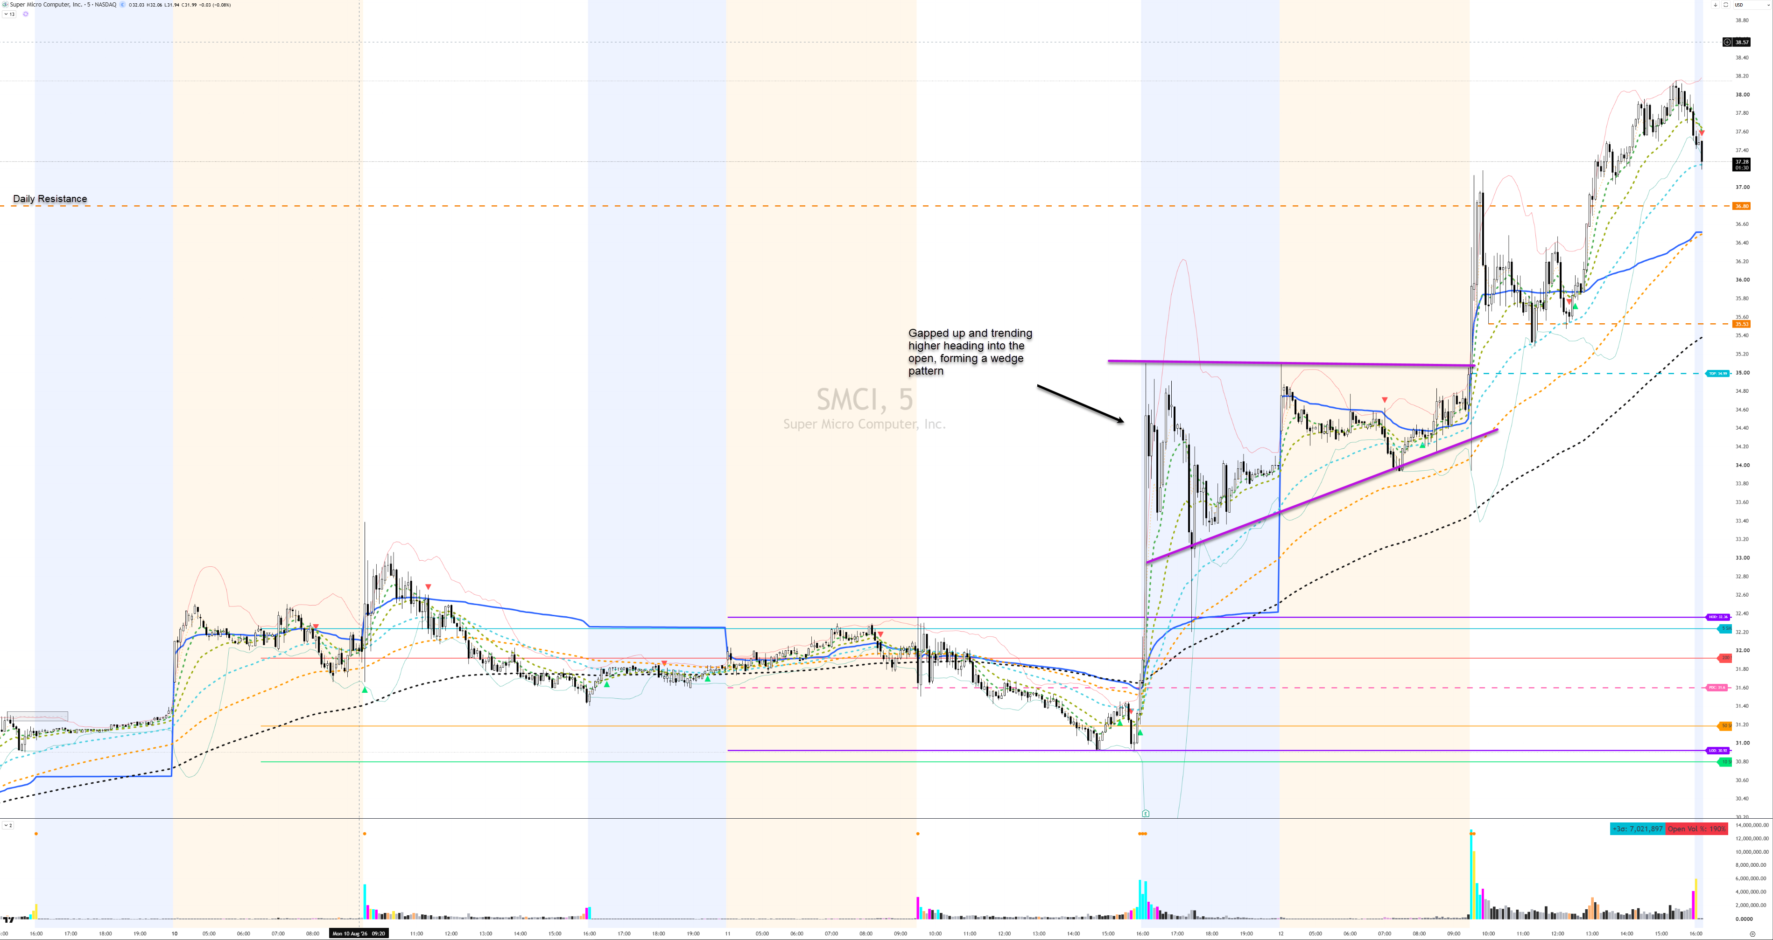
TECHNICAL ANALYSIS

Slide 8
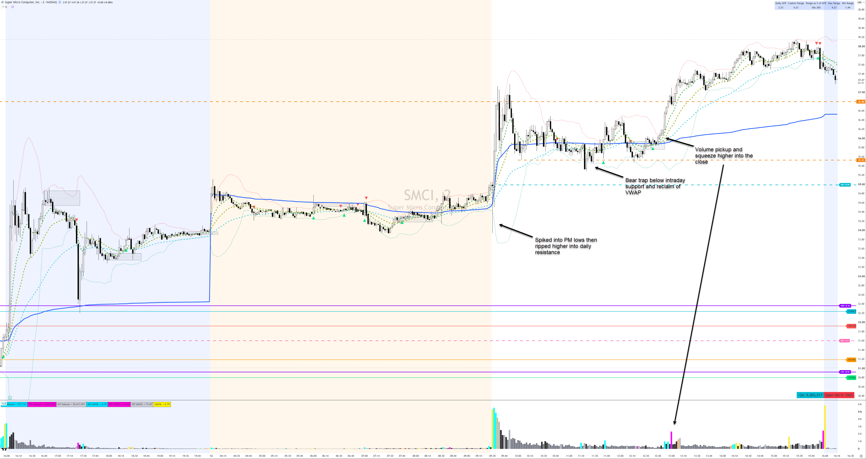
TECHNICAL ANALYSIS (extra slide)

Slide 9

TRADE STRATEGY
1. Wait for a trap on either side so that one side is offside
2. In SMCI, price traded under VWAP, then dipped below the morning support level only to reclaim it and VWAP, putting all shorts below VWAP offside
3. Wait for a consolidation above VWAP to confirm the trap
4. Wait for the volume spike to get long
5. Make sales into HOD
6. Trail runner on 2m 9ema

Slide 10
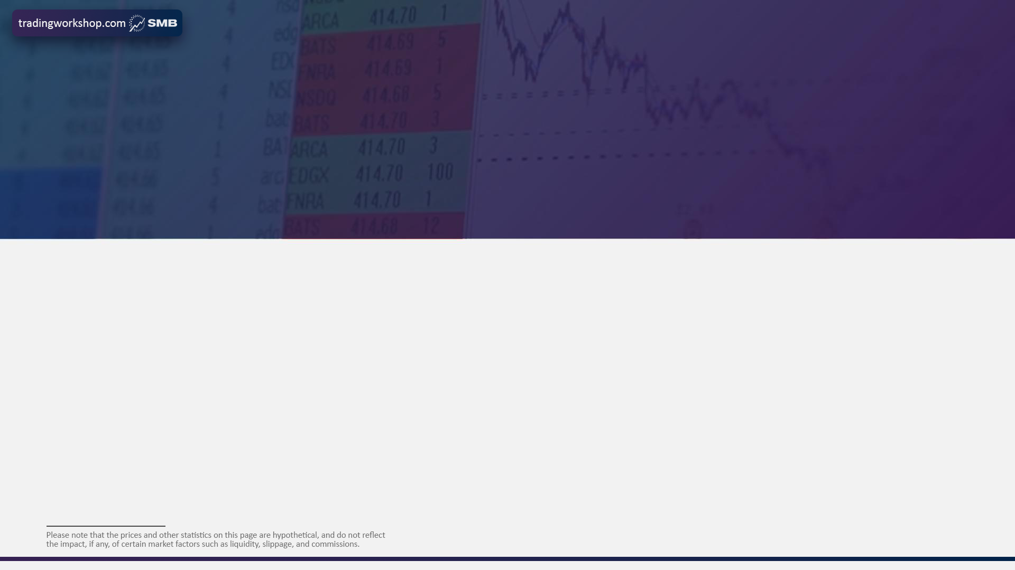
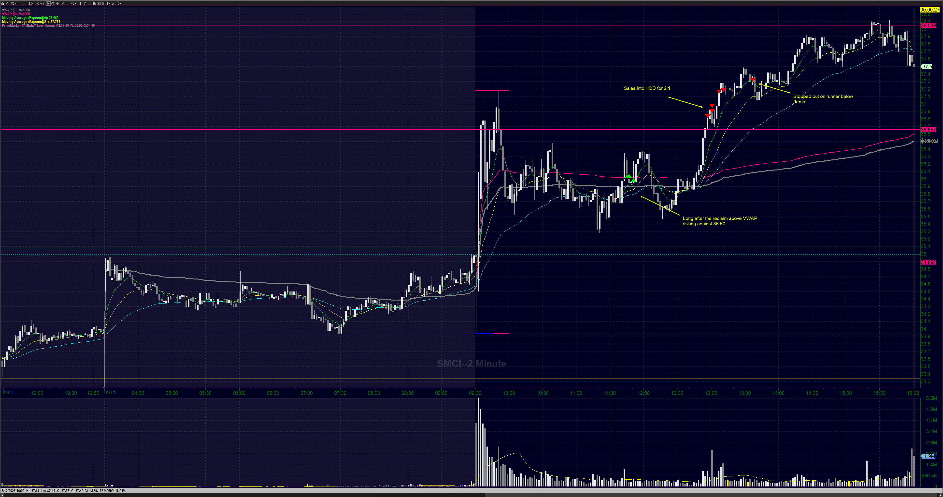
TRADE MANAGEMENT

Slide 11
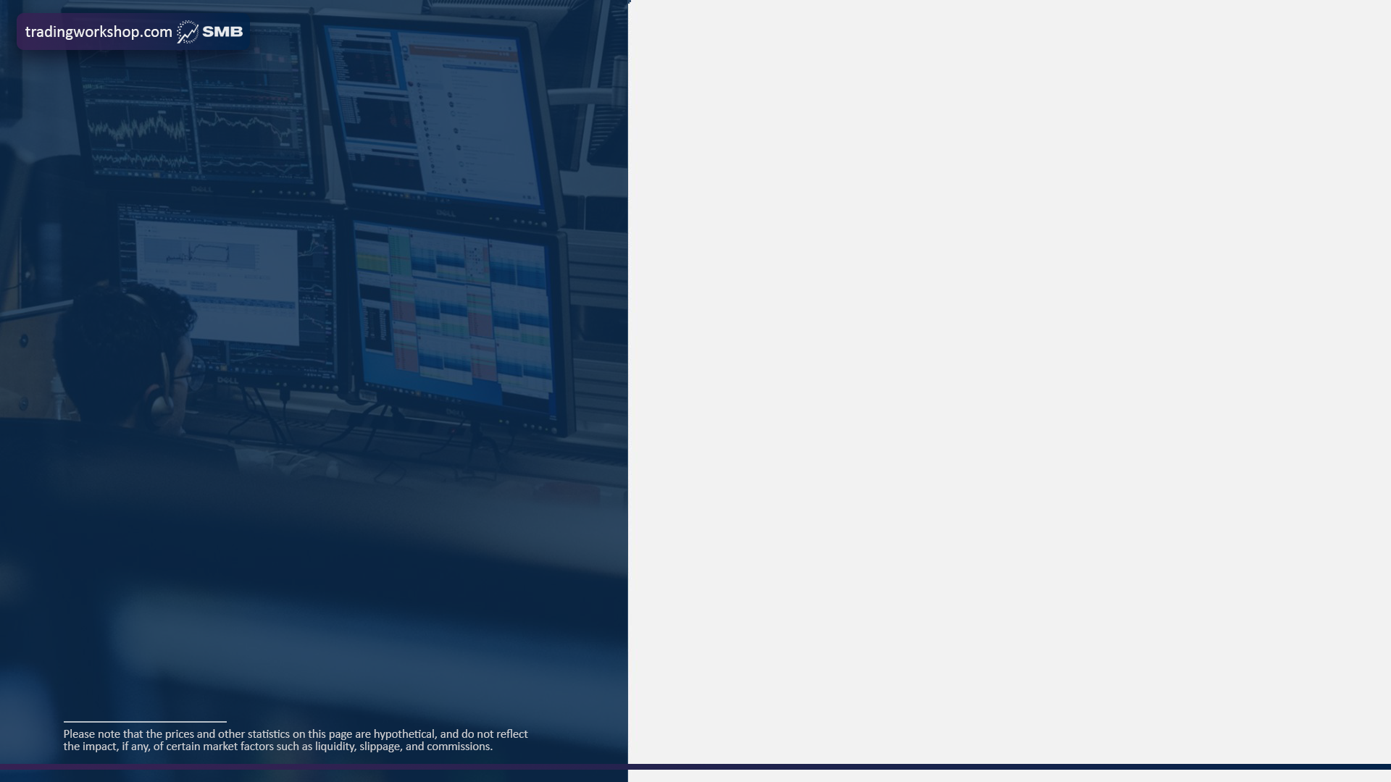
RISK MANAGEMENT
B
15%
How much will you risk on the trade?
What percentage of your daily stop loss will you risk?

Slide 12

TECHNOLOGY
- Charting/Indicators/Scripts: TradingView & ToS
- Morning Rundowns + Trading Infrastructure (scanners etc): Claude + VPS
- Execution Software: DAS with hotkey and scripts
- News/Reports: Vital Knowledge + Briefing + Hammerstone

Slide 13
TRADE REVIEW
I did not rush into this trade and let the opportunity present itself. The offside scalp was on once the bears were potentially trapped on the LOD and VWAP reclaim. As it was still with in a range, I pieced into the trade but was not at the full allocation. While still trading mid range, I did not want to add, with a plan to either add at the bottom of the range or once it broke out. Having to step away for dinner, was unable to do get the adds on as both opportunities presented themselves. But the time I got back to my desk, SMCI had started to rip. I made sales at the target and trailed the runner on the 9ema as per the trade plan.
- Right thesis and trade idea
- Risking against the correct level
- Didn't want to add to get to full size mid-range

